Slide 1
AURA
Assembly of university research administrators
February 10, 2021

Slide 2
Agenda
New Staff Introductions K. Kreidler
START - Proposal Routing Changes and PI Approval/Certification C. Martinez
START – Assignment to Dept/PI to Update Submission Status V. Bomben
START – Scheduled System Upgrade K. Kreidler
Coverage Analyses – Outsourcing and Fees K. Parks
Clinical Trial Budget Review and Approval K. Kreidler
90 Day Cost Transfers and Effort Certification V. Briscoe
Please mute and turn off cameras.

Slide 3
New staff introductions
Welcome!
Please turn on your camera and unmute when you are introduced and tell us a little about yourself.

Slide 4
START – Proposal Routing Changes
PI approval has been moved from Budget Review to Final Review
PI is notified of Budget Approval via email
PI will certify accuracy of the proposal
Bypassing PI approval is no longer an option – work with your faculty to coordinate this step!

Slide 5
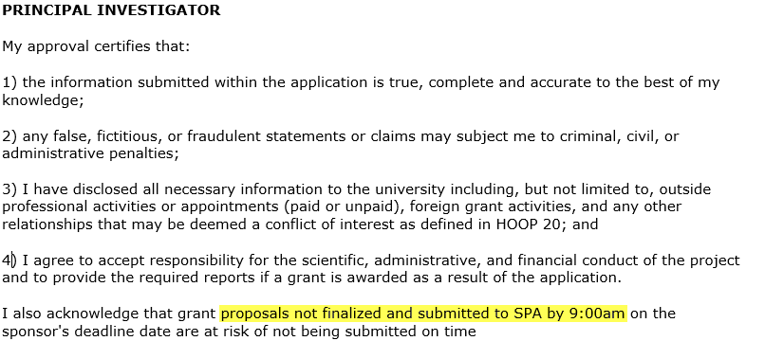
START – Proposal Routing Changes
New Certification language:

Slide 6
START – Proposal Routing Changes
Data entry in the system determines the routing steps
Routing decisions starts with Proposal Type selection during Step 2

Slide 7
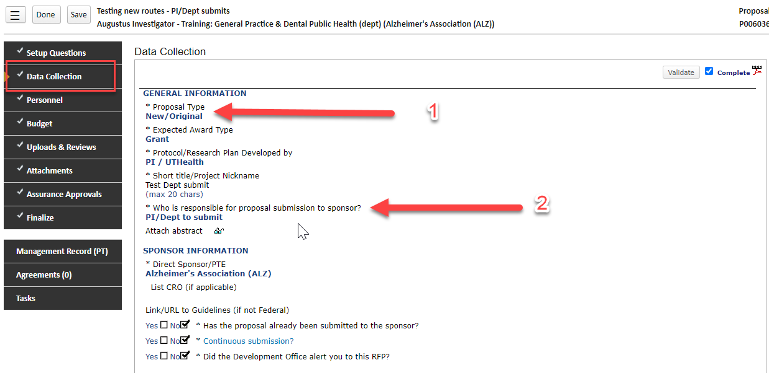
Other Routing decision points
Data Collection form (key points below)

Slide 8
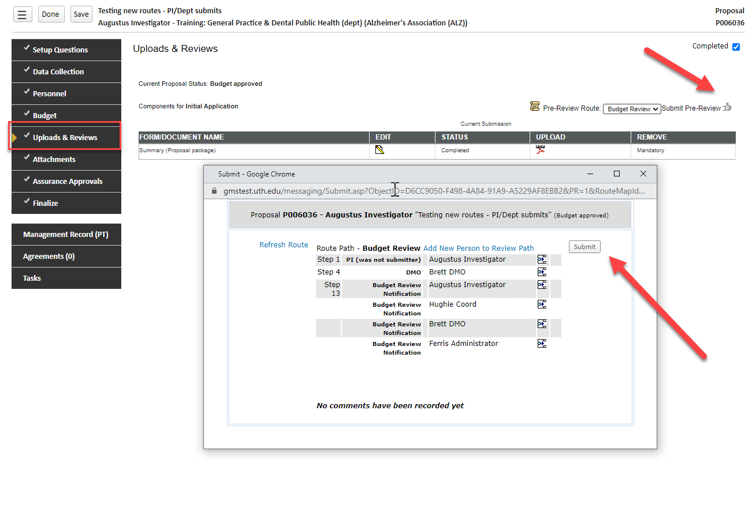
START – ROUTING STEPS
Review Your Route!

Slide 9
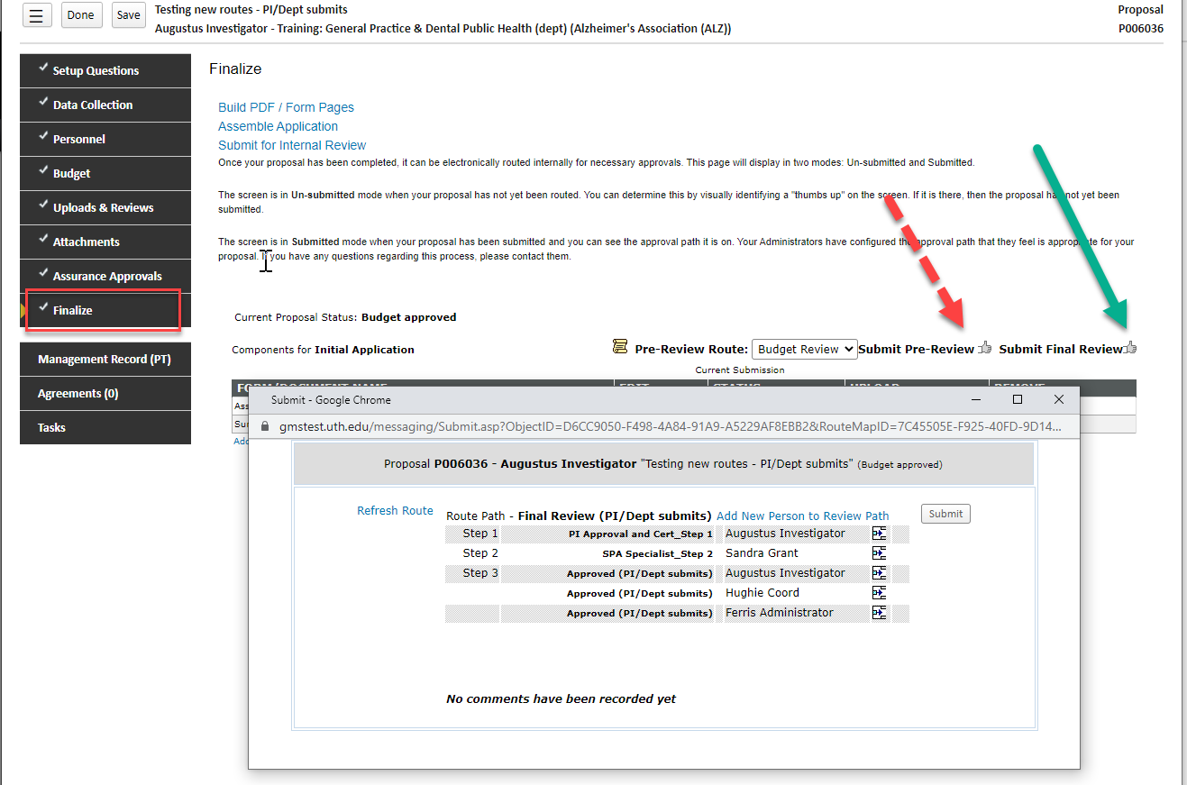
START – dept/pi assignment TO SUBMIT ROUTE
Review Your Route!

Slide 10
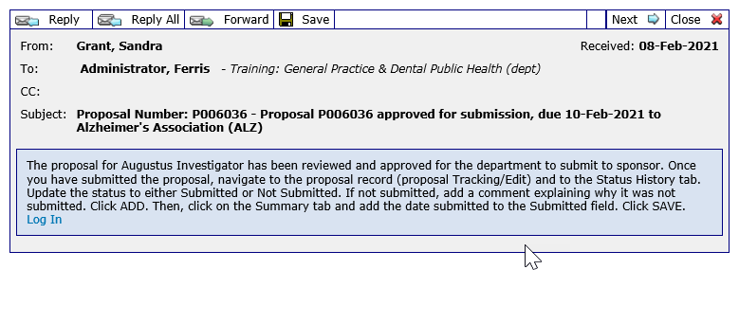
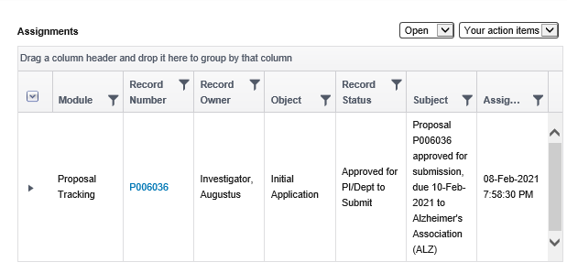
START – dept/pi assignment TO SUBMIT ROUTE

Slide 11
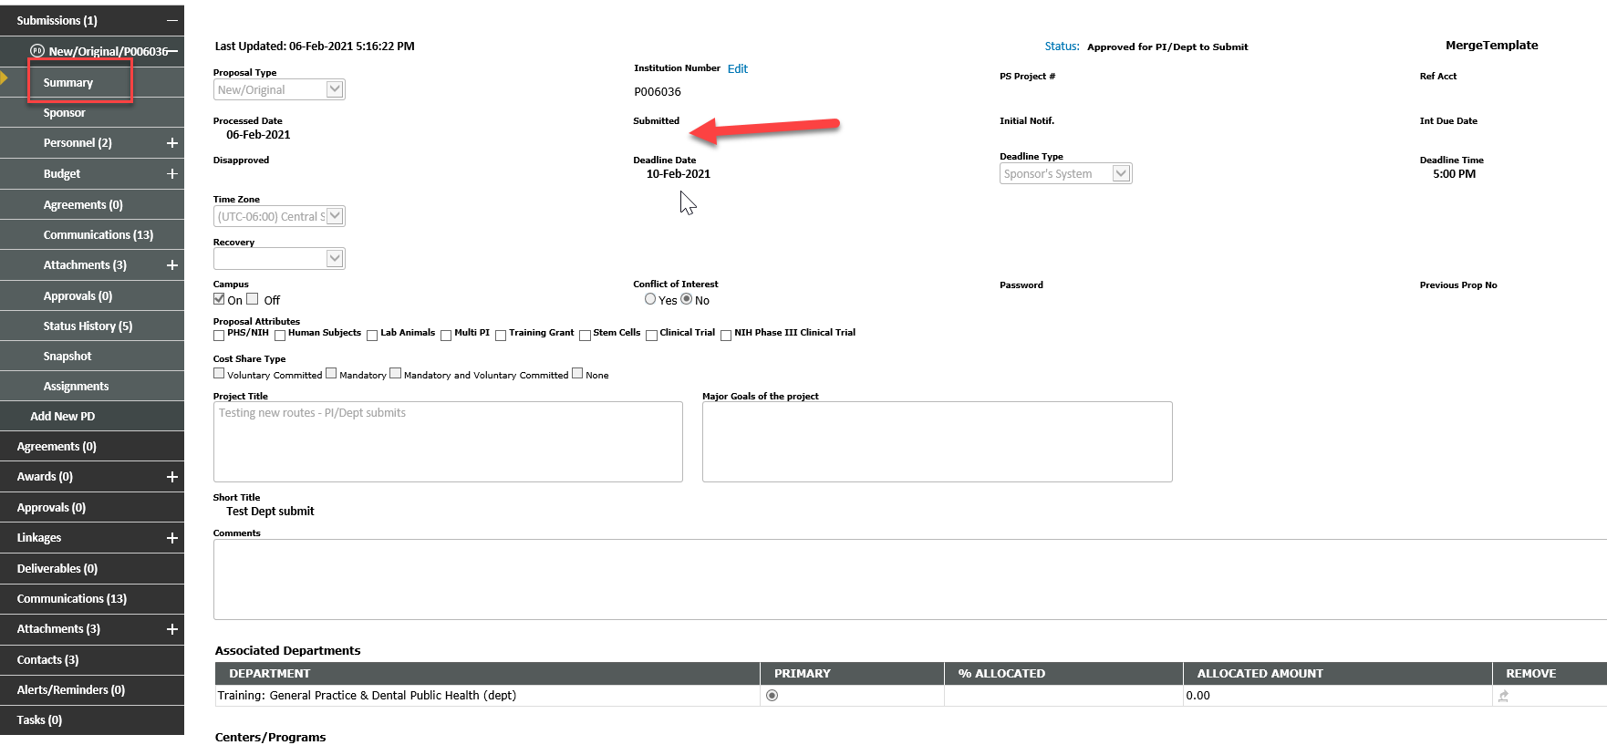
START – dept/pi assignment TO SUBMIT ROUTE

Slide 12
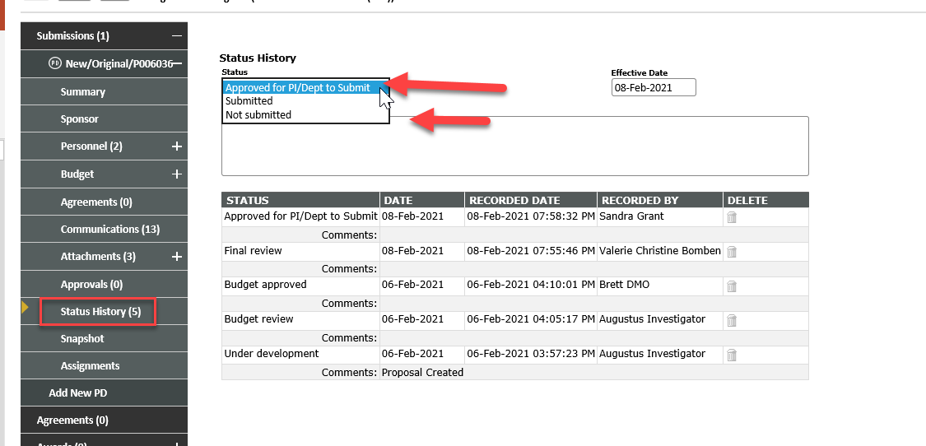
START – dept/pi assignment TO SUBMIT ROUTE

Slide 13
START – AFTER the FACT ROUTE
After the Fact Route : Updated to land directly in “Submitted” rather than “Agreement in Negotiation”
If an award is being made as well as a proposal needs to be reviewed, please make sure to follow up with action item needed (agreement linked for negotiation, NOA, RCOIs, approvals attached)

Slide 14
START – scheduled system upgrade
START system upgrade to newest version
Scheduled for March 15, 2021 – May 17, 2021
Transparent to end-users until move to production on May 17, 2021
Achieve better system stability
Correct several issues/errors
Add new features
Updated User Guides will be added to SPA website with crosswalk of changes

Slide 15
Coverage analysis outsourcing and fees
UTHealth has contracted with Huron Consulting Group to complete Coverage Analyses:
- Loss of staff/expertise
- turnaround time
- workload shift from study staff and SPA to Huron

Slide 16
Coverage analysis outsourcing and fees
UTHealth has contracted with Huron Consulting Group to complete Coverage Analyses:
- Loss of staff/expertise
- turnaround time
- workload shift from study staff and SPA to Huron

Slide 17
Coverage analysis outsourcing and fees
CA’s for industry sponsored clinical trials will permanently transition to Huron
Departments must now budget CA fees into start-up costs
Mandatory for all Industry CAs initiated in START after 2/28/21
Department study staff no longer required to complete the CA
“CA assigned to Huron” is now a status in START
Fees will be charged to studies monthly via journal entry
Fee will be split between direct and indirect costs

Slide 18
Coverage analysis outsourcing and fees
Most non-industry CA’s will be sent to Huron until SPA CRFA team is re-staffed and trained:
3 – 6 months
SPA will cover all fees for industry studies for CAs created in START through 2/28/21
SPA will cover all fees for non-industry/investigator initiated studies through 8/31/21

Slide 19
Coverage analysis outsourcing and fees
Initial – Industry
 | Direct | Indirect | Total
Low Complexity | $ 1,100 | $ 330 | $ 1,430
Medium Complexity | $ 2,200 | $ 660 | $ 2,860
High Complexity | $ 2,800 | $ 840 | $ 3,640
Amendments – Industry
Low Complexity | $ 600 | $ 180 | $ 780
Medium Complexity | $ 800 | $ 240 | $ 1,040
High Complexity | $ 1,000 | $ 300 | $ 1,300
Sponsors are used to seeing/paying these fees

Slide 20
Coverage analysis outsourcing and fees
Study Complexity Level | General Characteristics
Low | PI-Initiated or industry-sponsored simple study. Items tend to be paid by the sponsor and the schedule of events in the protocol has very few items. Low complexity studies may simply involve biospecimen samples and office visits
Medium | Largest complexity group for clinical trials. PI-Initiated or industry sponsored study. Items will be both sponsor paid and conventional care. The schedule of events in the protocol will contain several items but is usually limited to one arm.
High | Typically, high complexity studies are industry or federal sponsored clinical trial. These studies have a high number of conventional care procedures. They may involve multiple cancers, multiple arms, and cutting-edge treatment such as stem cell therapy.
Huron will assign a preliminary complexity for budgeting purposes.
Medium complexity is the most common

Slide 21
Coverage analysis outsourcing and fees
CRF completes billing risk assessment for study to determine if CA is needed
Study Documents sent to Huron (Protocol, informed Consent, IDE/IND Number, participating cohorts and/or sub-studies)
Huron completes initial review, assigns prelim Complexity level and assigns to CA Developer
Completed CA returned to UTHealth within 10 business days (average is 7 days)
UTHealth reviews and approves CA
Huron will provide weekly status report.
All CAs will be completed within 10 business days. (Average is 7 days.)

Slide 22
CTA budget review and approval
CTAs are submitted to SPA for budget review and financial congruency check prior to execution of the CTA agreement.
- Final CA-budget grid must be attached to the PD record
- Budget entered into PD record must match the CA_budget grid (total estimated revenue)
DMOs/Dept Managers should be reviewing these two items before approving:
Is it complete?
Is it accurate?
Is it realistic?

Slide 23
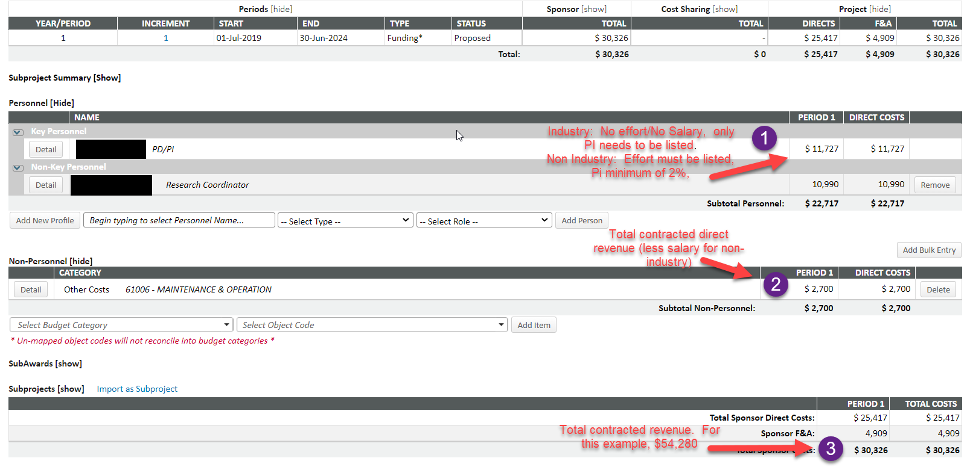
CTA budget review and approval

Slide 24
90 day cost transfers and effort certification
Effective immediately, cost transfers must be completed within 90 days of when the cost is incurred.
Federal requirements have become more restrictive for funds access, so keeping up with final expenses and retro needs is more important than ever in order to be able to actually draw down final federal funds.
Effort reporting is negatively impacted when retros are not timely. Effort reporting should not be the only time when personnel review is completed.

